Slide 1
Old Technology – Windows’ Batch Files
I told some friends I was giving a presentation on batch files and they laughed. I guess because though it was such old tech or unworthy of discussion?
I like batch files and think they are still relevant because you can create self-documenting scripts that you can evolve and perfect over time.
Does anybody use Windows' batch files?

Slide 2
Table of Contents
Part I – The Problem: Many batch files have spaghetti code.
Part II – The Answer in my opinion is functionalization.
Part III – How customization can increase your productivity.

Slide 3
Part I of III - The Problem: Most Batch Files Are A Mess
Most batch files I've seen in the wild are pretty messy. They are often quite long and not well structured. I know this partly because I've written hundreds of them over the years that were a mess. I like to think I'm a little better now.
For Example, I googled "typical batch file" and this was the first hit:
https://www.instructables.com/id/5-Cool-Batch-Files/

Slide 4
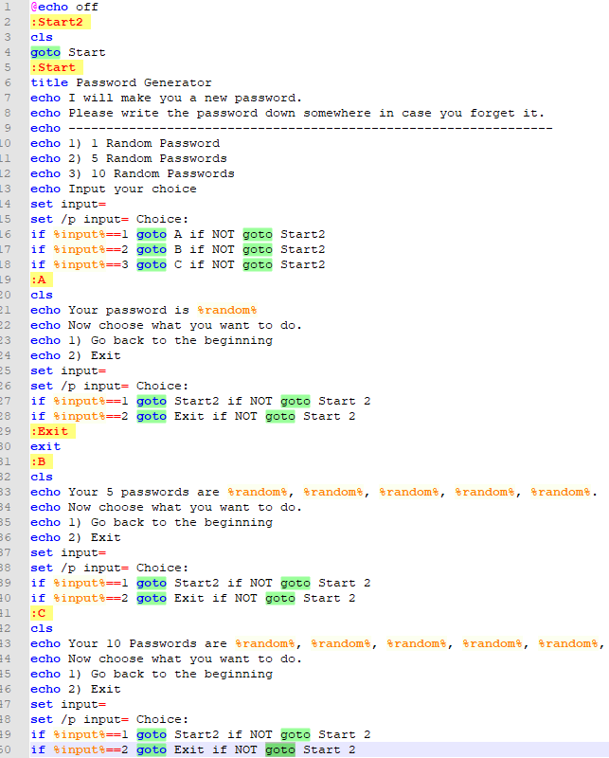
This small file has 19 goto statements! Makes my head hurt looking at it.
The lack of standard structure is a problem and leads to code that is hard to follow and understand.

Slide 5
Part II of III - How to Modularize?
So let's impose some structure. In most programming languages there's a concept of a function. At the heart of Composable Batch Files is the enforcing the use of traditional functions or decoupled code blocks.
Anatomy of a function. Here are the basic structural elements:
* [label] = function name (which must be unique within the file).
* call :[label] = function call to another function in this batch file.
* goto [label] = also a function call, which does not return to the caller. Use judiciously.
* call [batch2] [label] = call to another batch file function.
* exit/b = end of function. The lack of exit/b is the most common culprit. Without ending functions, you have spaghetti code.

Slide 6
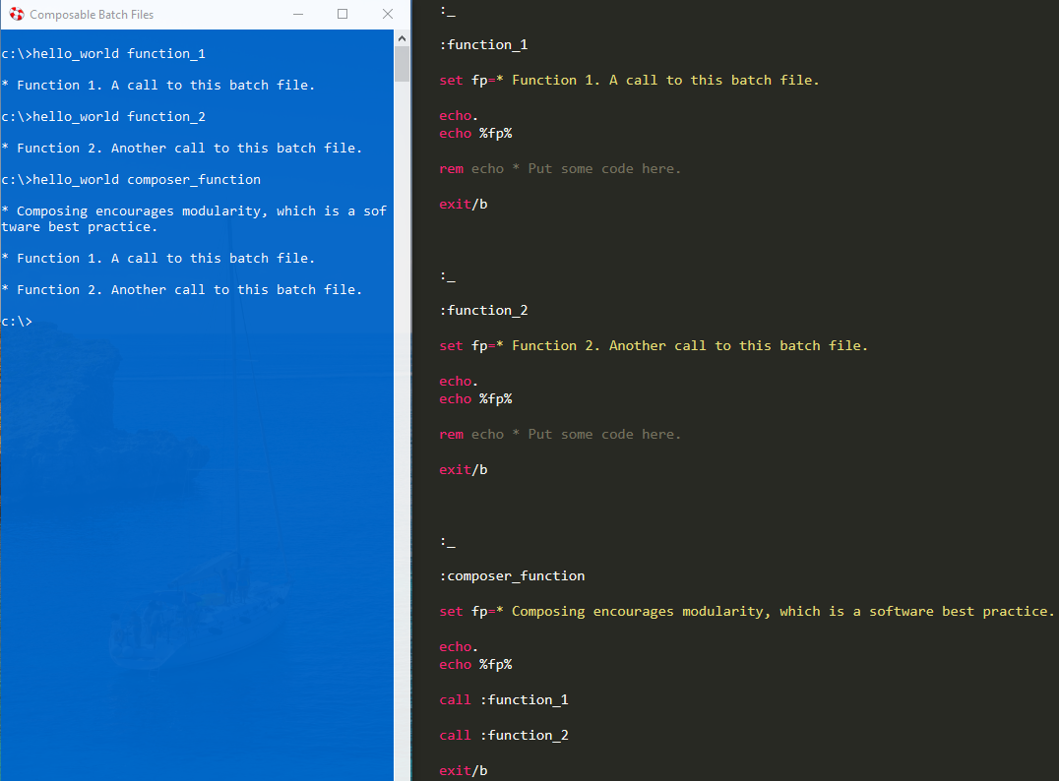
Hello World - A Functionalized Approach
Building the batch file around the a set of functions can turn a normally disorganized environment into a structured and organized one.

Slide 7
Repo Setup Instructions
Add %COMPOSABLE_BATCH_FILES% as an environment variable or, at least, add it to your path to where you installed the repository.
If you so choose, also add these environment variables for the following:
* %CBF_DEFAULT_BROWSER%
* %CBF_DEFAULT_TEXT_EDITOR%

Slide 8
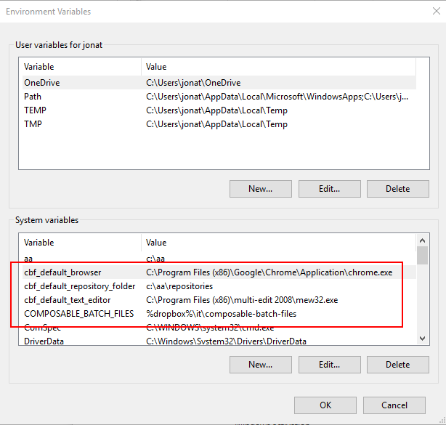
Here's an example of how to set some CBF default environment variables:

Slide 9
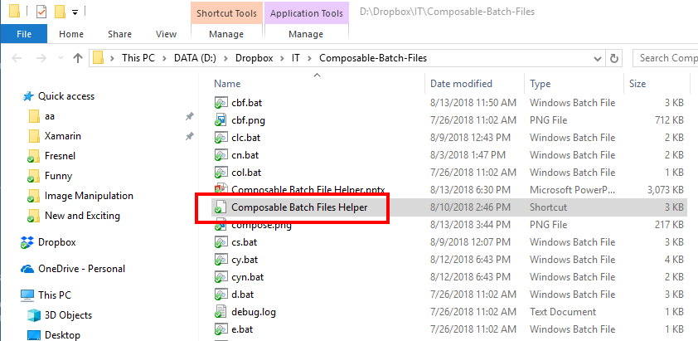
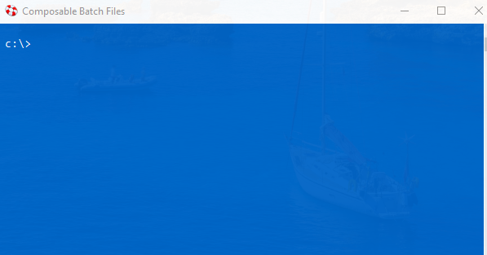
Done with Setup
After you have cloned or downloaded the CBF repository, double click the shortcut titled "Composable Batch Files Helper" to open up a blue command prompt, which will initialize your environment.

Slide 10
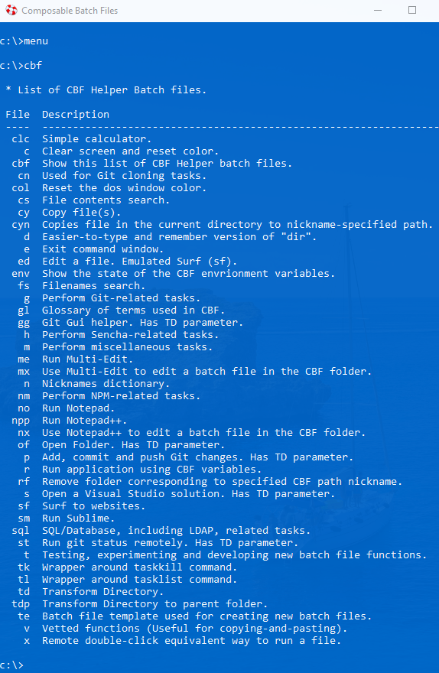
Menu
To see a menu of all of the out-of-the-box available CBFs type "menu" or "cbf" at the prompt.
All of the batch files in CBF use a functionalized, modular approach.

Slide 11
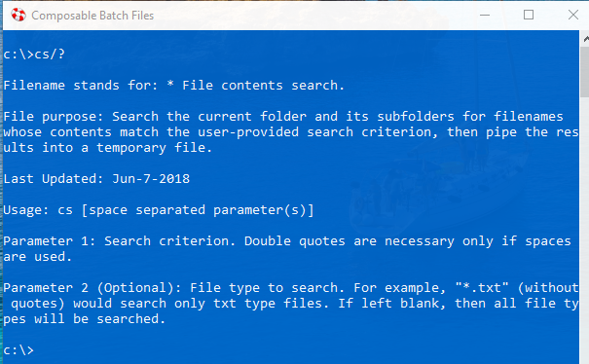
Getting Help
To get help with a particular batch file, at the prompt type "[batch file name]/?". For example:

Slide 12
Part III of III: Customize CBF by Leveraging Environment Variables
Besides functionalization, another feature CBF promotes is leveraging environment variables in order to customize your CBF user experience. This is achieved by mapping nicknames/function names to environment variables. There is a CBF file named n.bat (Nicknames Dictionary) whose sole purpose is to do this mapping. For example, in n.bat, you could add a function with the nickname/function name of "docs" which maps the Documents folder to the cbf_path environment variable. Then because another batch file td.bat (Transform Directory) makes use of this mapping, typing "td docs" would navigate to the documents folder.
This is like creating a bookmark for a folder.

Slide 13
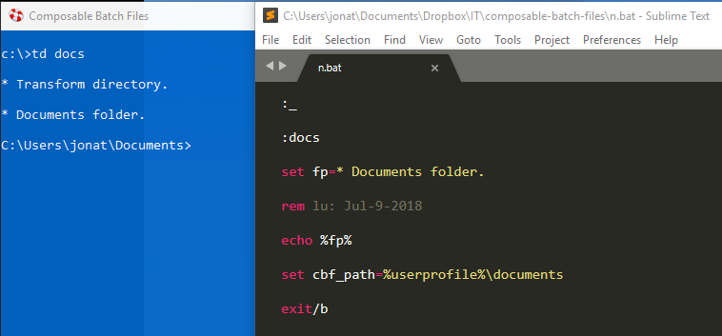
TD is probably my favorite CBF because it speeds up navigating the file system.

Slide 14
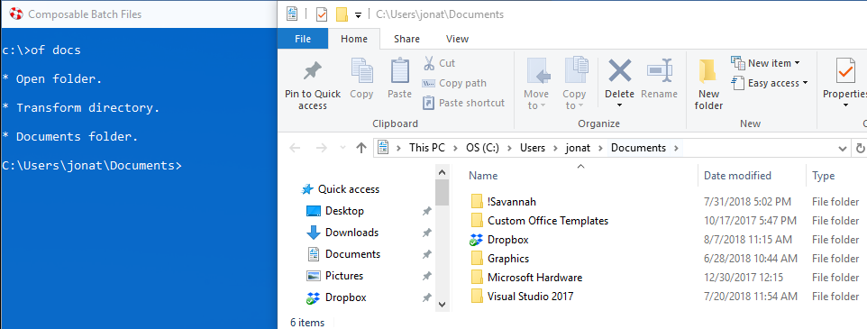
Leverages the same environment variable.
Since of.bat (Open Folder) also leverages the "cbf_path" environment variable, typing "of docs" would open the documents folder in Windows Explorer.

Slide 15
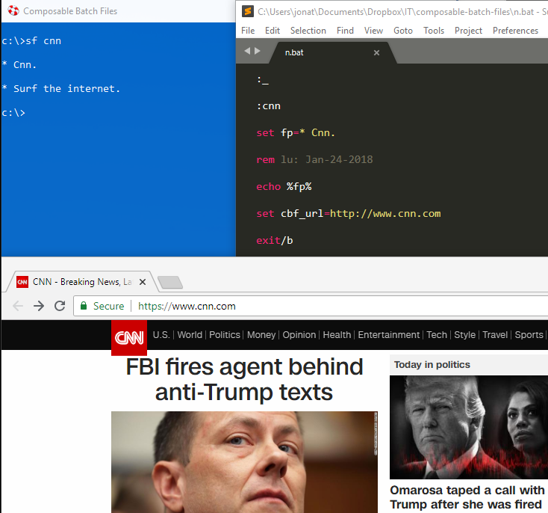
Sf.bat (Surf) leverages the "cbf_url" environment variable. Acts a like a text-based bookmark.

Slide 16
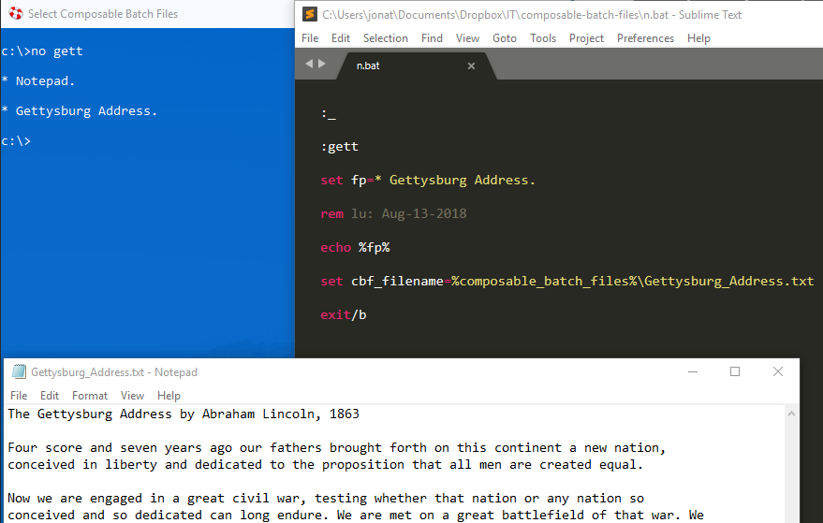
No.bat (Notepad) leverages the "cbf_filename" environment variable. Like a bookmark for a filename.

Slide 17
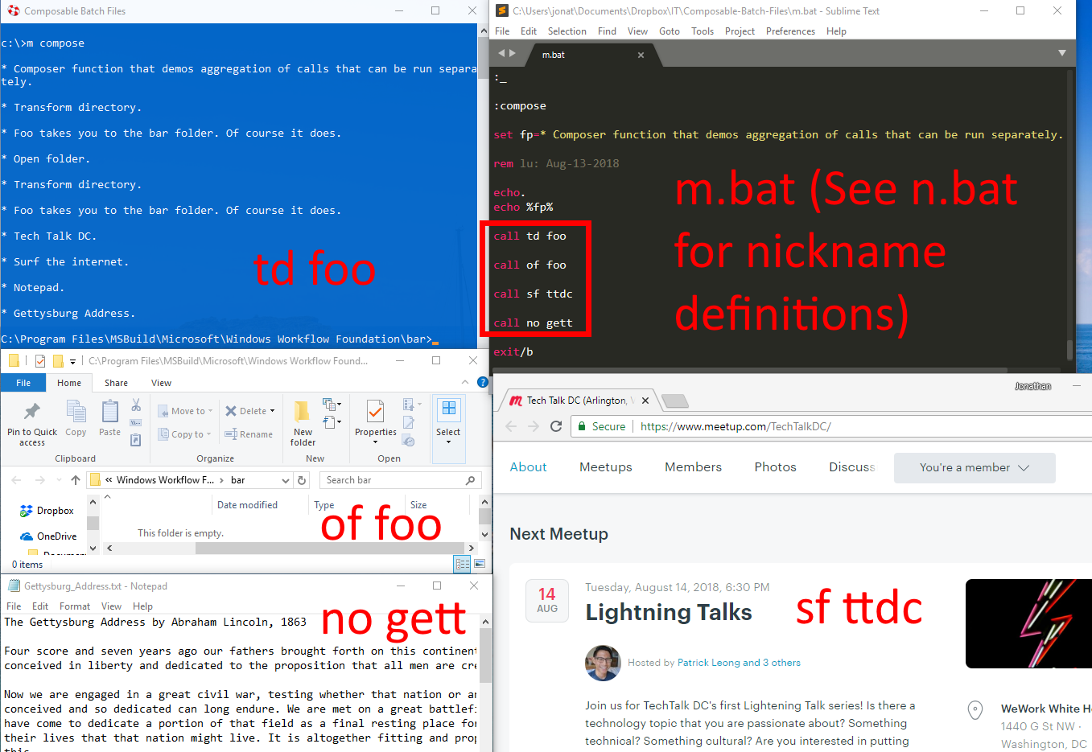
Composer Method – Run them all together.

Slide 18
Live Demo
Hello_World
Just to prove it works, run: m compose
2 of my favorite out-of-the-box batch files I use on a regular basis.
Run fs.bat, td ux, fs *.sln against 92 Xamarin University Repos
I know you can do the same thing in Windows Explorer, but you can use this method if you prefer the command line or perhaps need a text file of the search results.
Run cs.bat, td ux, cs UriImageSource *.cs

Slide 19

Questions? To download and for more info., see:

